Slide 1
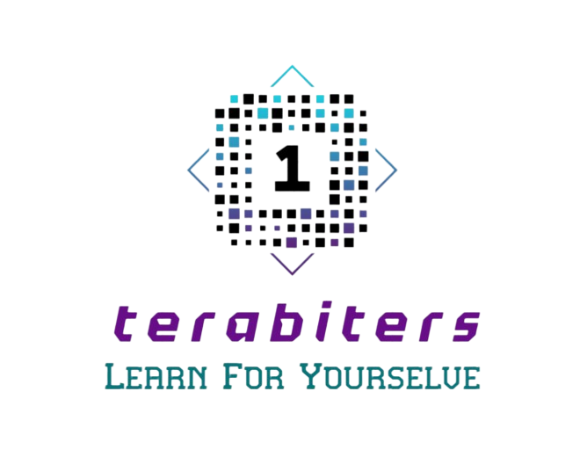

Slide 2
Presentation stages
01
02
Team
Idea
03
04
Work stages
app

Slide 3
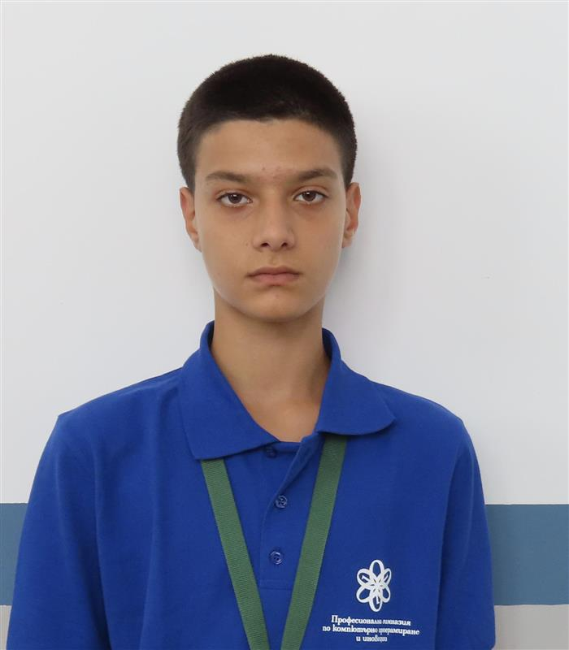
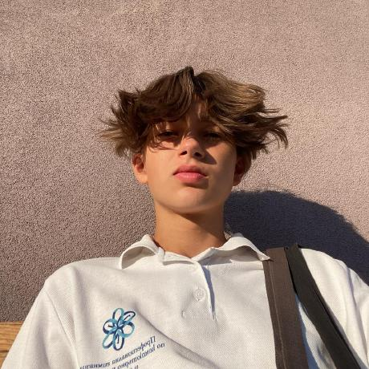
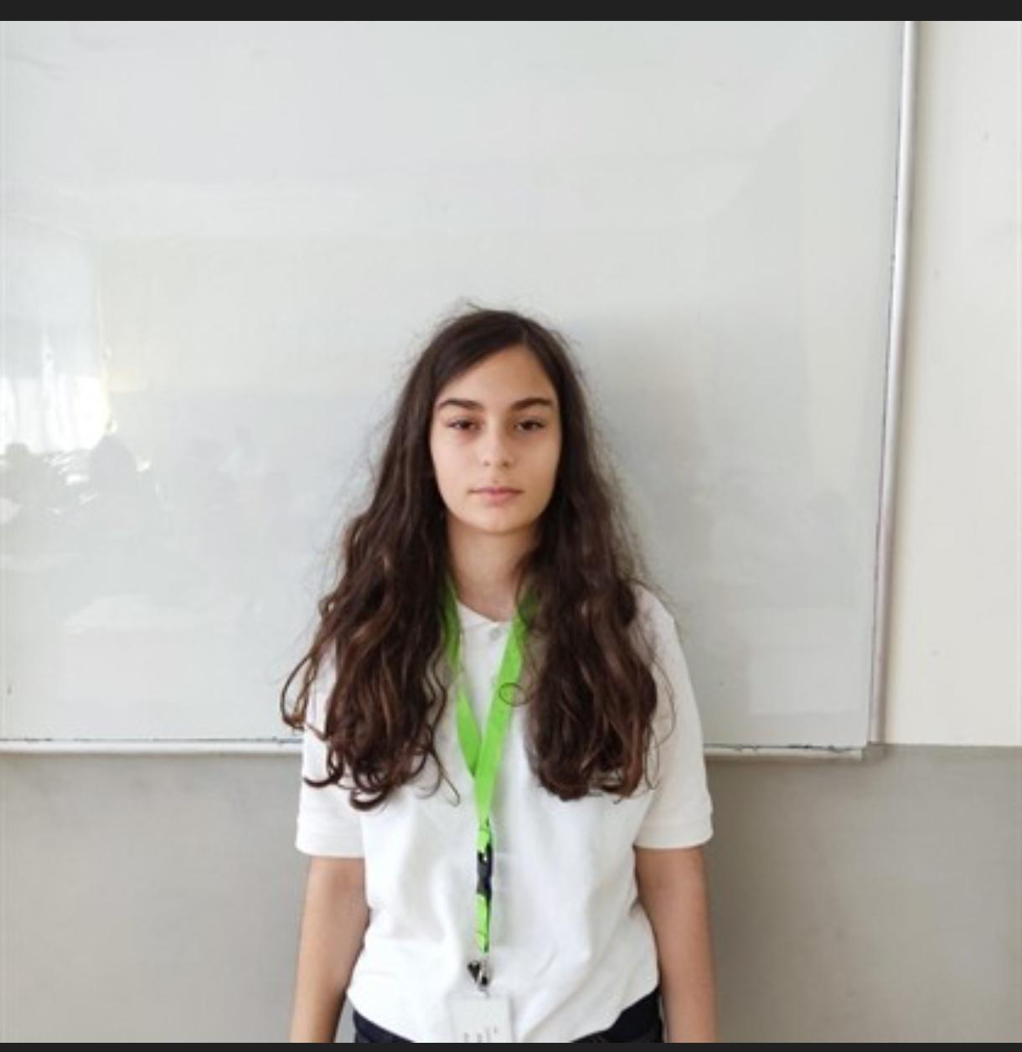
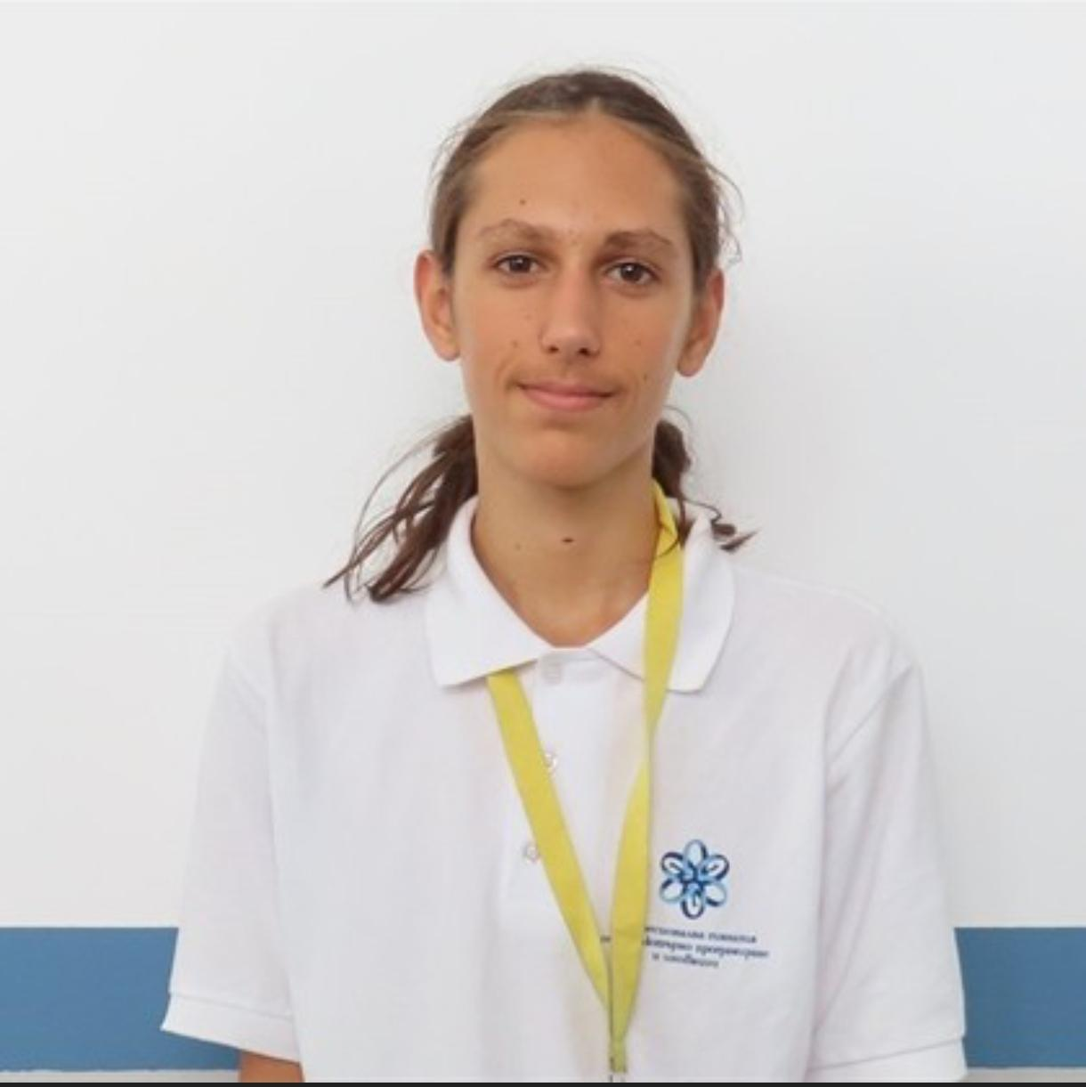
Team
Аликс Абдула
Backend developer
Иван Бекнев
Scrum Trainer
ГабриелаСтоянова
Backend developer
Дамян Керчев
Frontend developer

Slide 4
Idea
"Terabyters" achieves success in the development and implementation of an innovative educational platform that transforms the way learning and teaching are conducted. With a strong focus on accessibility, personalization, and innovation, "Terabyters" turns education into an exciting and impactful experience for students worldwide.

Slide 5
Work stages
Form a team
Develop an idea
Work on project
Finish the app
Project documentation
Rehearsal for the project presentation

Slide 6






Used technologies

